Slide 1



A PRODUCT BY CORONASG
TEAM MEMBERs:
Ang Zhan phung Edmund u1822350G
Brenda ng xin en u1822002H
Emmanuelle vania u1720742K
Ang Yong xin U1821708G
How Mo xuan u1620038J
Sam jian shen u1821296l
Notes:
Hi there, today our team is proud to share with you guys the new product LarkDetect, a product by Team CoronaSG. The team members as shown.

Slide 2
Scope
Background
Product Introduction
Design for Maintainability
Software Quality Assurance
Project Management
Risk Management
Conclusion
Notes:
The scope that we will be sharing will be as shown.

Slide 3

Background
Objective
Target Group
Type of Test
Notes:
So, with the growing concern of ageing population in Singapore, one in 10 people aged 60 and above may have dementia.
You may ask, why is this of a concern? Please note that dementia is not a part of normal aging, it is a condition that causes progressive intellectual decline leading to increasing difficulties in coping with everyday activities. There is evidence that medications for dementia may be more beneficial for patient that have been diagnose early.
Thus, with this consideration in mind, our team came out with a online platform LarkDetect (click), LarkDetect is a online trail making test which is targeted for users age 40 and above.
From the name itself, which stands for early detection, where Lark is a type of bird which wakes up the earliest.
The Trail making test which is a neuropsychological test which have clinical utility in classifying cognitively healthy older adults and patient with dementia.
So, Sam, as a front-end developer, what are the exciting features that are ready for our users?

Slide 4
Product Introduction
Notes:
chill Edmund I know you are as excited as the audience do, which I will share as I introduce our state of the art product! So let's begin!

Slide 5
Production Introduction
Overview
Environment
Registration
The Test
The Result
Notes:
I will guide you through our product, we start looking at the larger picture of our product which is our overview and dive down into the details such as the test and the result.

Slide 6



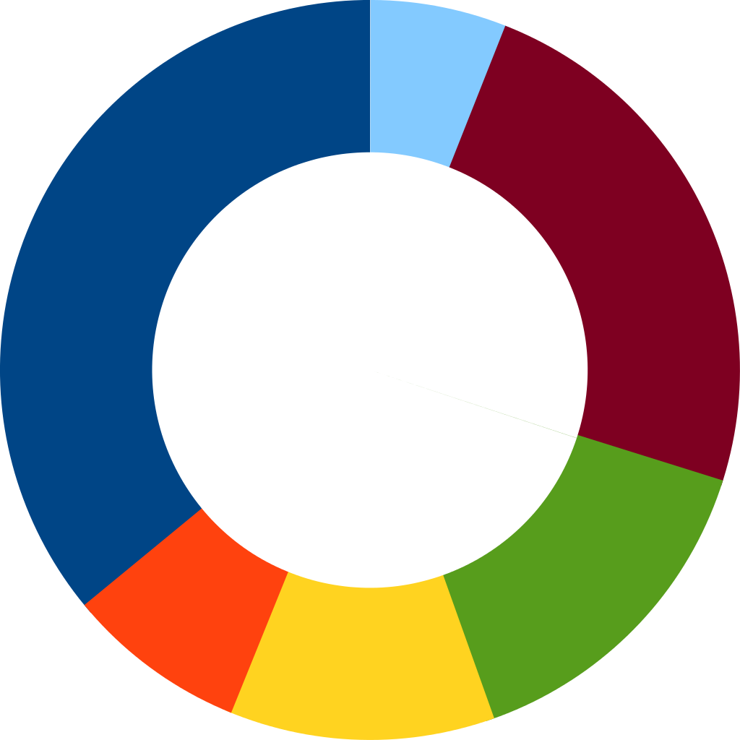



Overview
Users
Register
The Test
The Result
40 years old and above
Doctor
Access
List of Individuals Results
Notes:
We have account system in place to ensure only targeted audience is using our system. The users will be able to view their result after or before the test. The doctor will have access to every individual result.

Slide 7

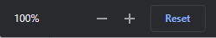
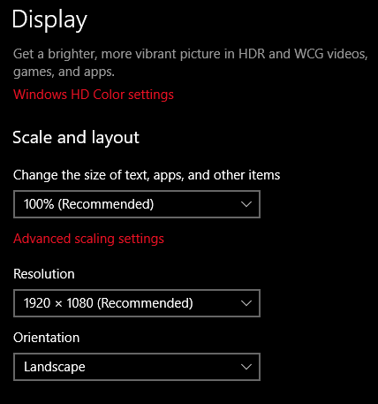

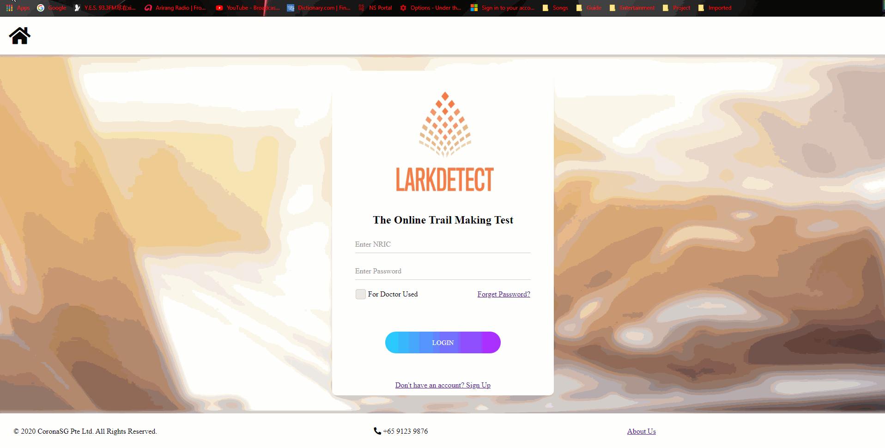

Environment
Our URL : larkdetect.mooo.com
Internet
Scale
Monitor
Browser
Version 80.0.3987.149 (Official Build) (64-bit)
or above
Notes:
Setup requirements to access our sys are as follows, firstly to have internet access, the right version of google chrome browser, to access our page is through our website called larkdetect.mooo.com. For best user experience, the users are recommended to set the scaling and monitor as shown here.

Slide 8
Registration
Register
Login
Reset Password
Main Page
Notes:
Once setup is done, the user have to register their account, before able to login into main page.

Slide 9
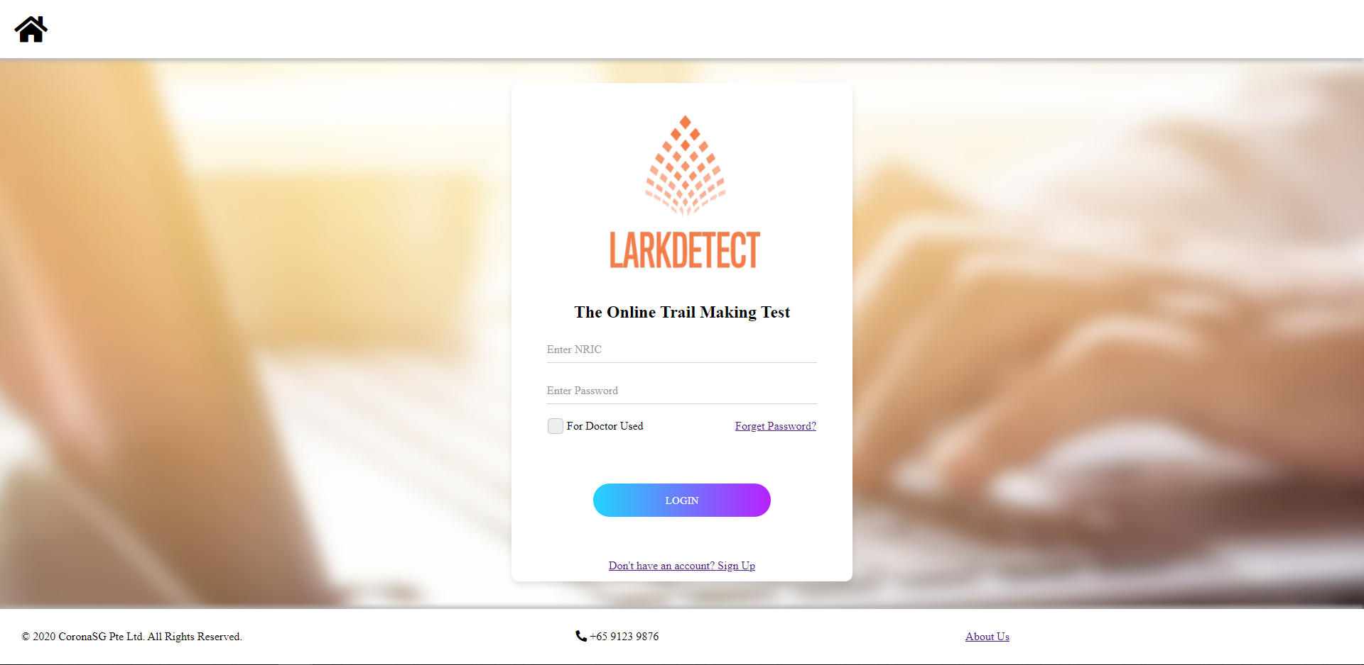
Registration
Register
Login
Reset Password
Main Page
Notes:
This should be the 1st UI the user see, to register is to click the green box as shown.

Slide 10
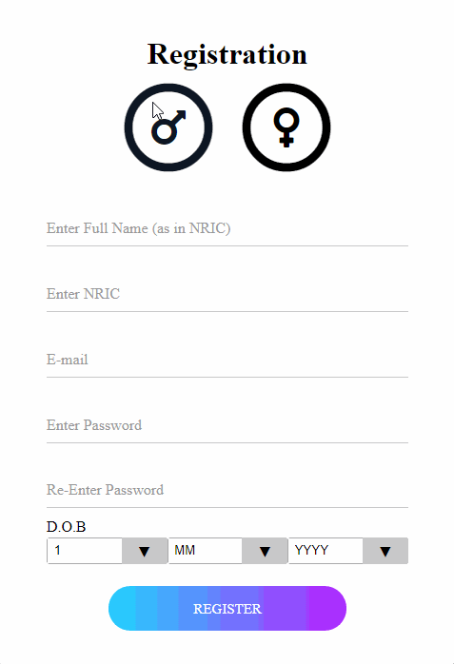
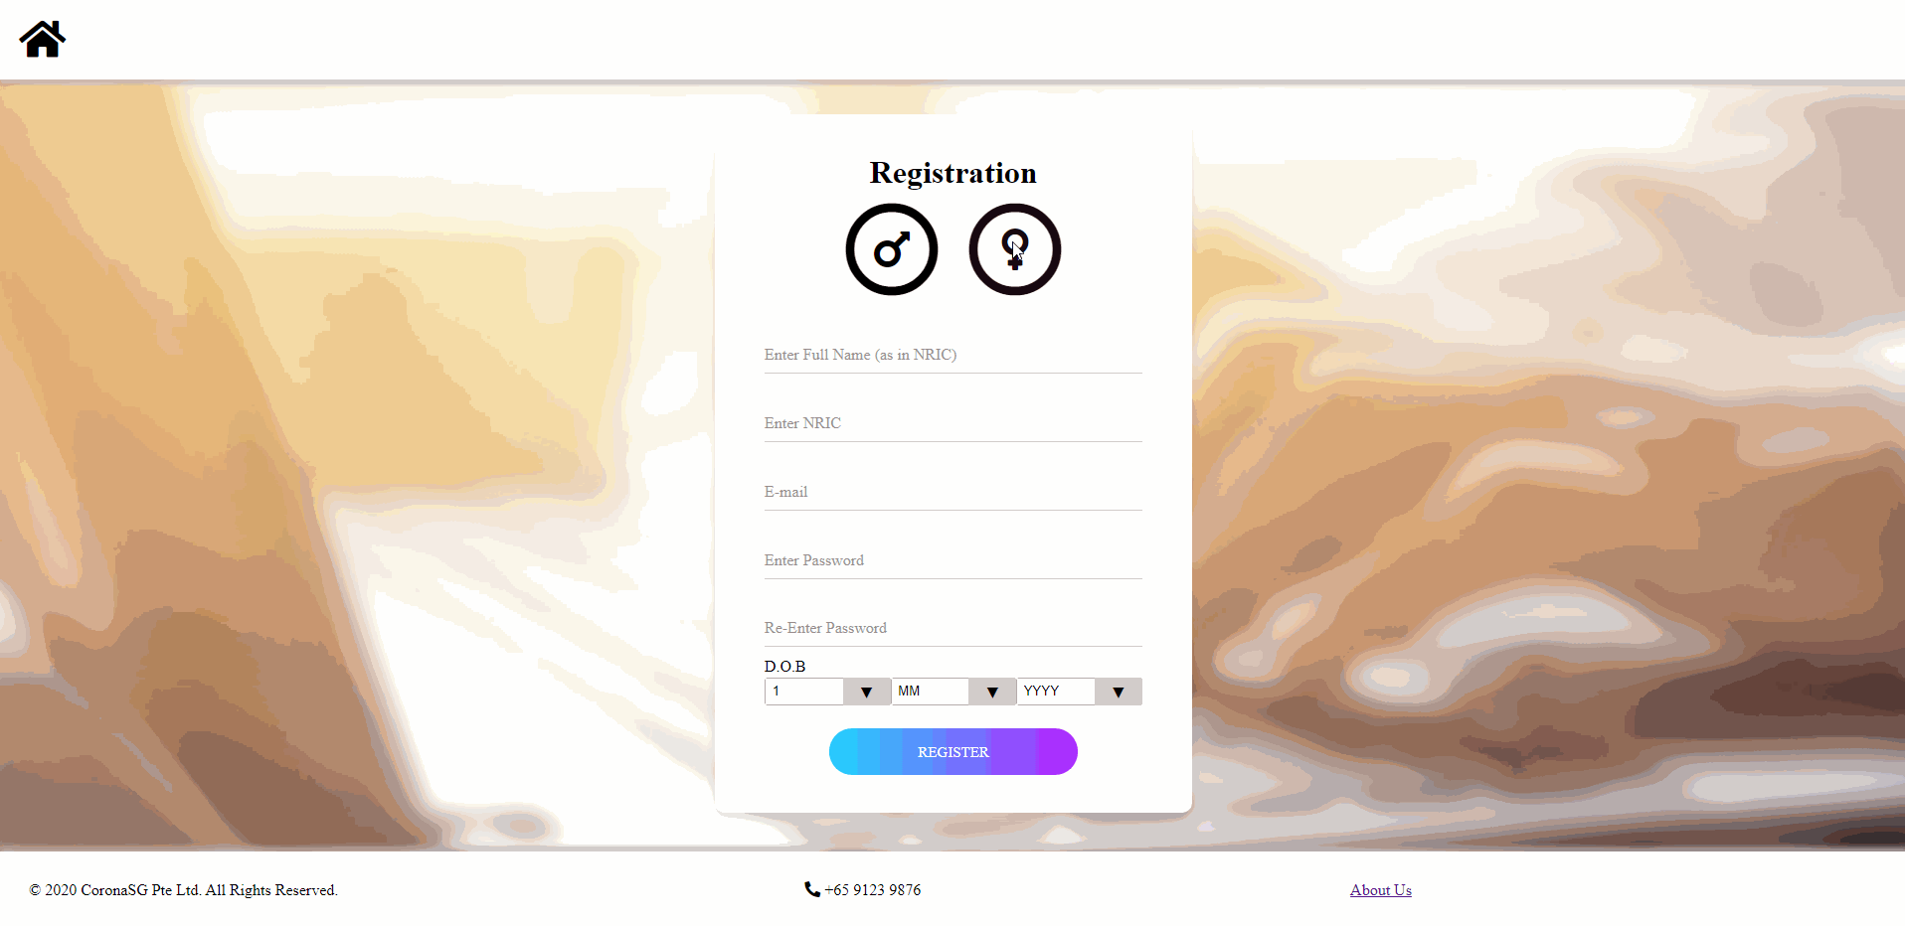
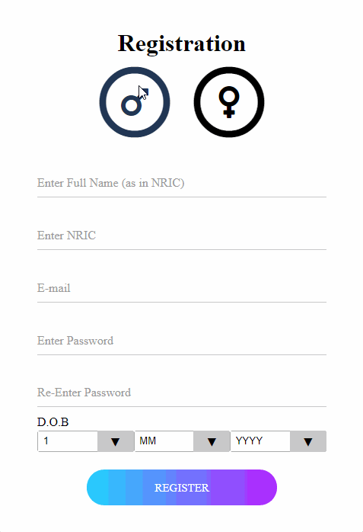
Registration
Blank
Register
Login
Reset Password
Main Page
1.Gender
2.NRIC
3.FULL NAME
4.E-Mail
5.Password
Requirement
6.D.O.B
Notes:
Users will have to fill up his/her particulars. Constraints have been set to ensure proper formatting in order to register their account successfully.

Slide 11

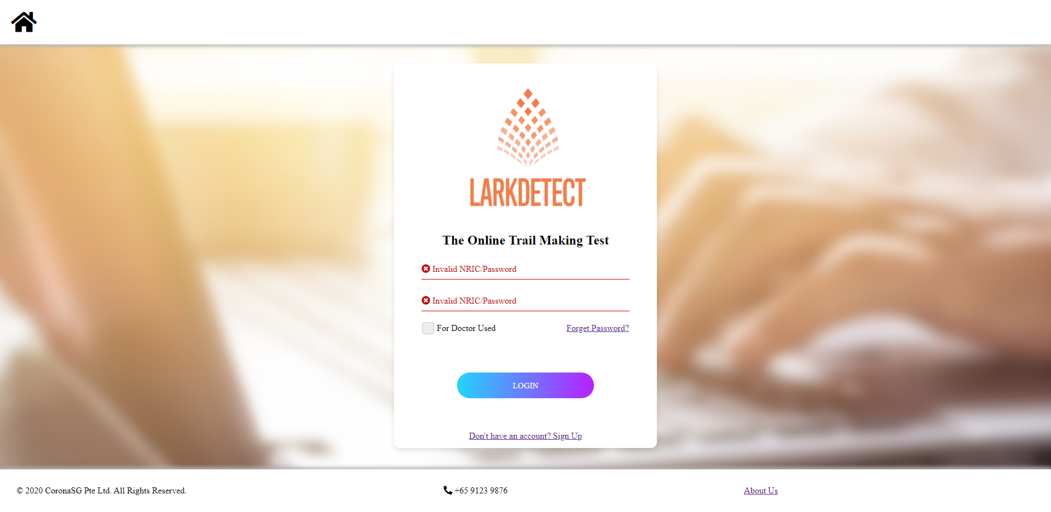
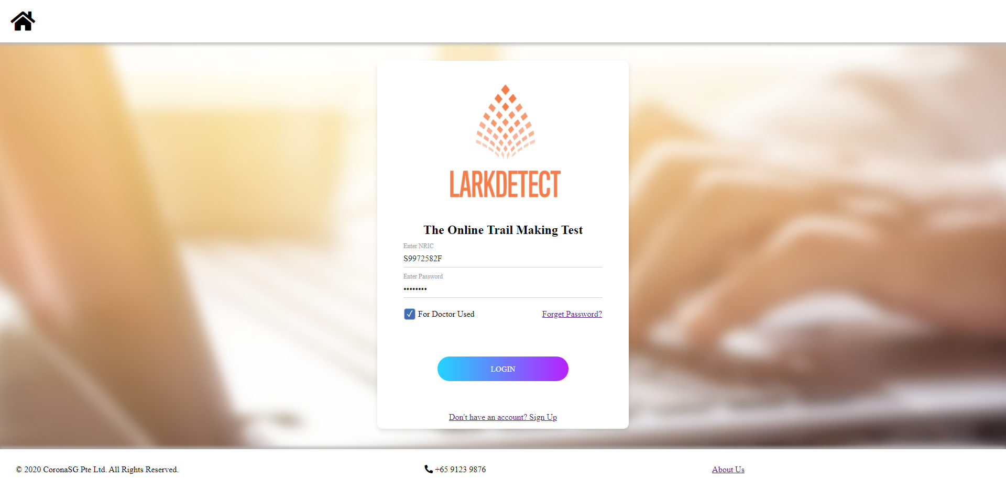
Registration
Register
Login
Reset Password
Main Page
Access Rights
Set By Admin
No Registration Needed
Notes:
Once sign up is done, user have to login correctly, should user forget their password user can click on the forget password text as shown in green box. For doctor they do not need to register as it is setup by our administrator.

Slide 12
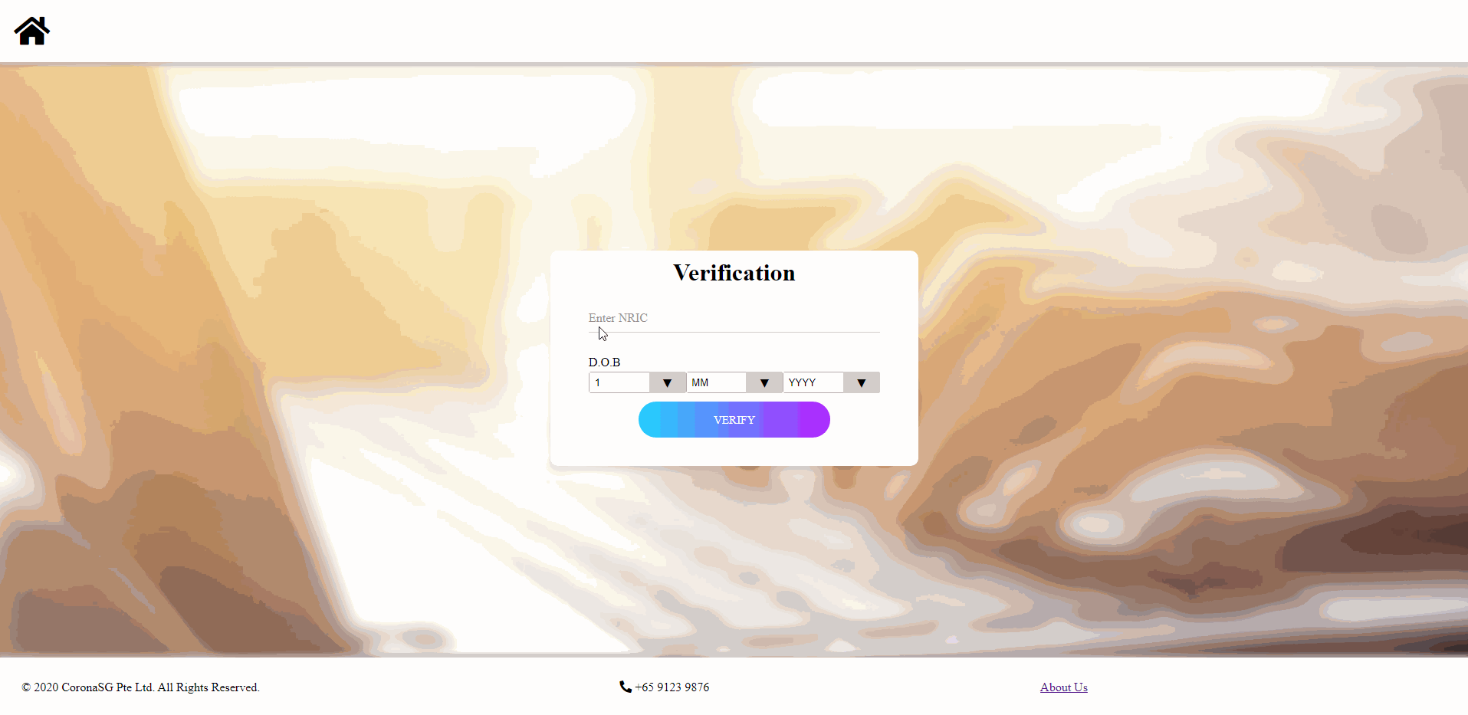
Registration
Register
Login
Reset
Password
Main Page
Notes:
Once click, the user will need verify and reset password accordingly. We used D.O.B as a verification variable when resetting the password.

Slide 13
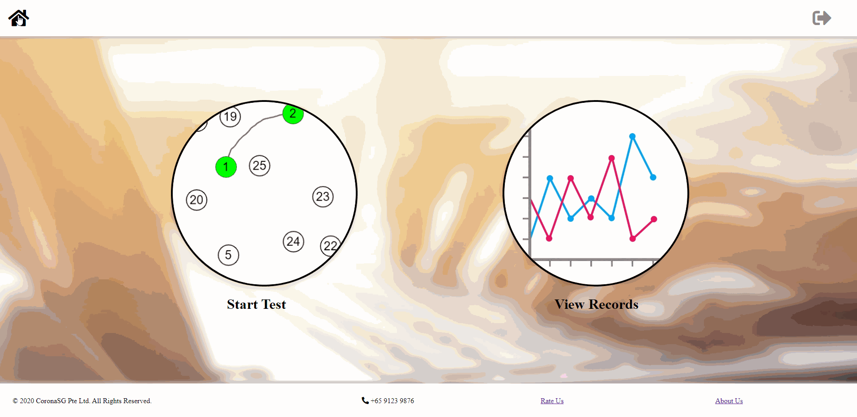
Registration
Main Page
Log Out
Register
Login
Reset Password
Main
Page
Notes:
In the main page, the user can choose to start the test or view their past test’s result if let say the user have done the test before.

Slide 14
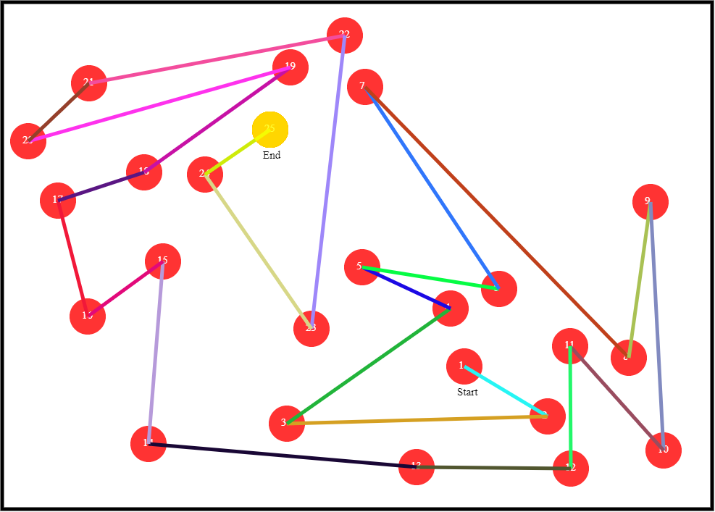
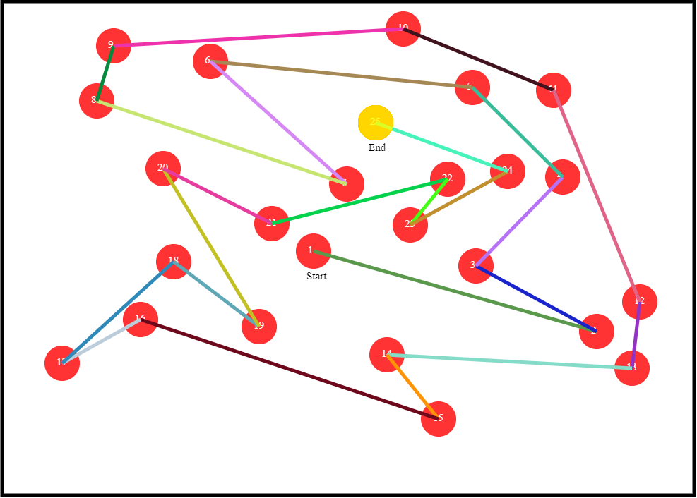
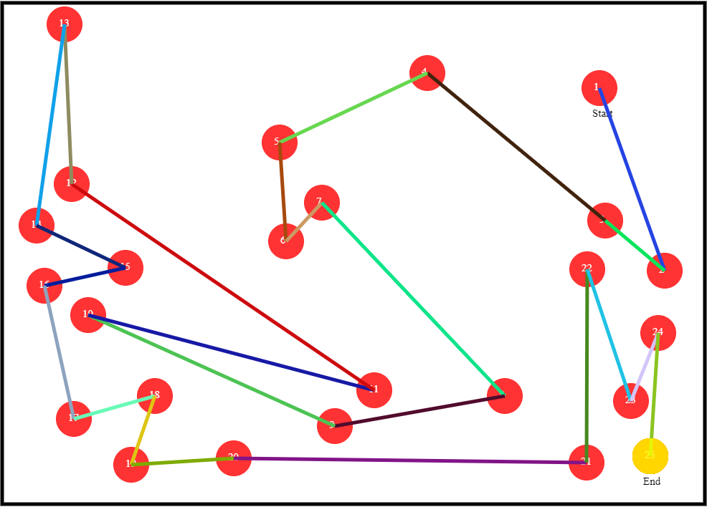
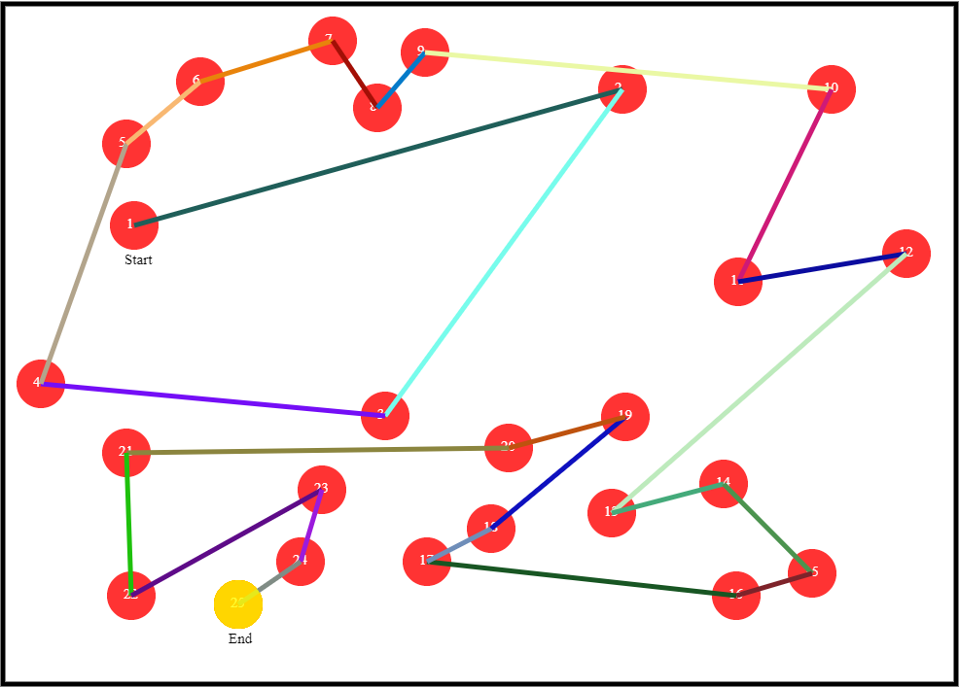
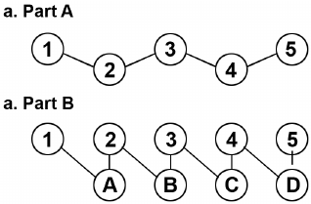
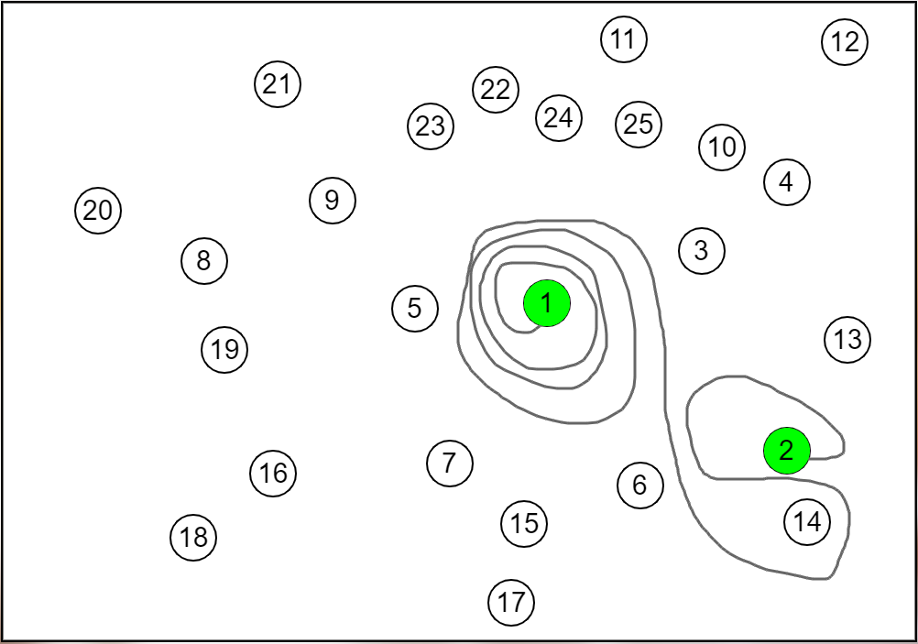
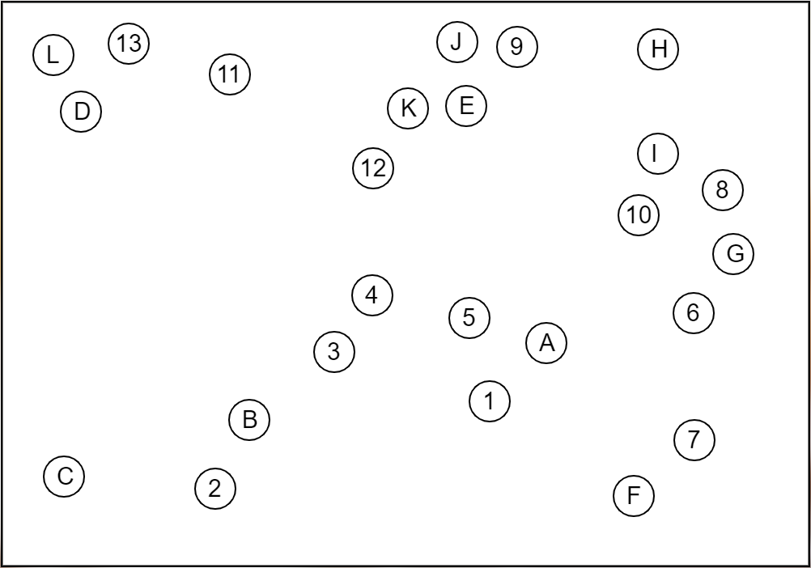
The Test
Random Generated
Test A
Test B
…
L
…
25
Notes:
The test consists of 2 form, test A which require the user to connect in ascending numerical order up to 25 dots, similarly for test B, is in this pattern until L. Test-Dots are randomly generated to ensure fair and credible results.

Slide 15
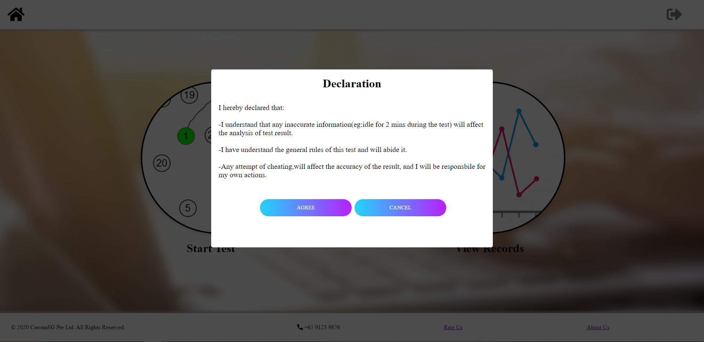
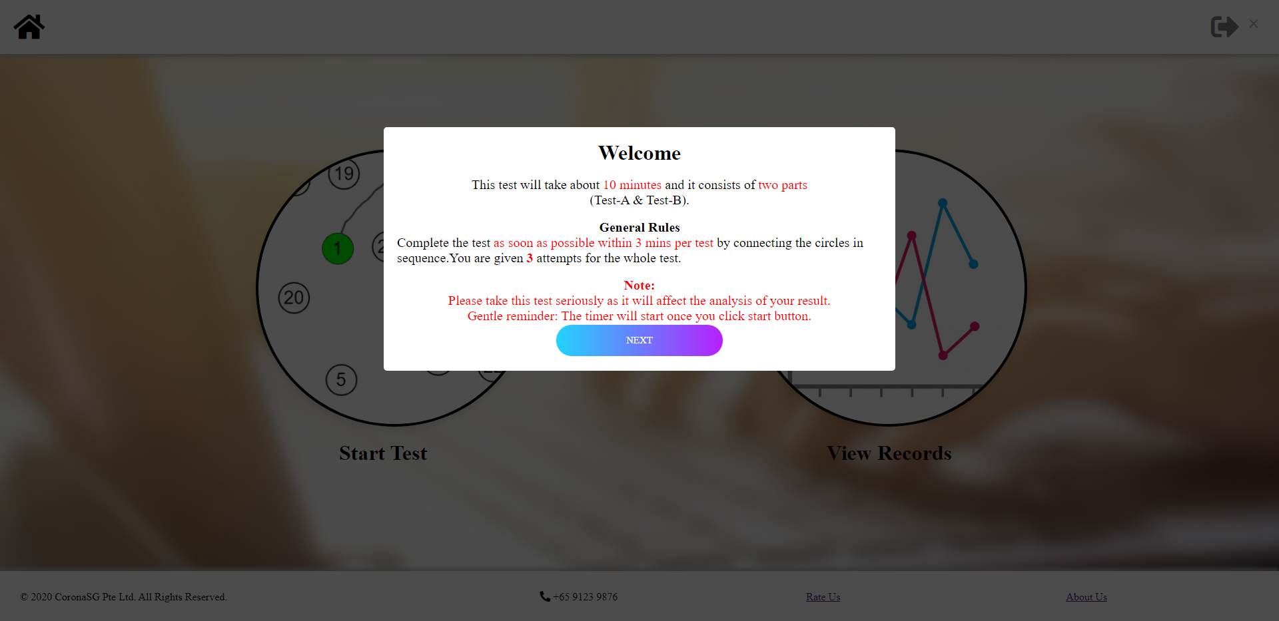
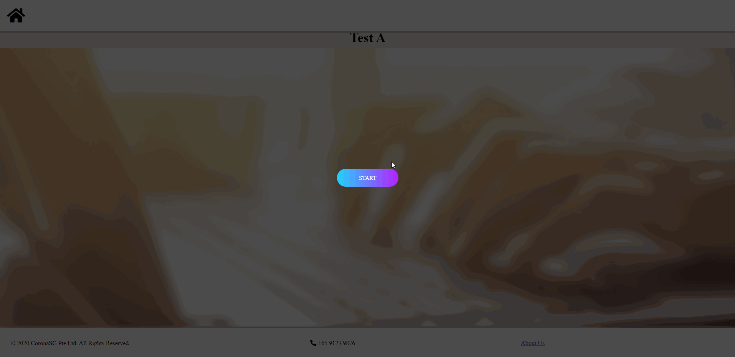
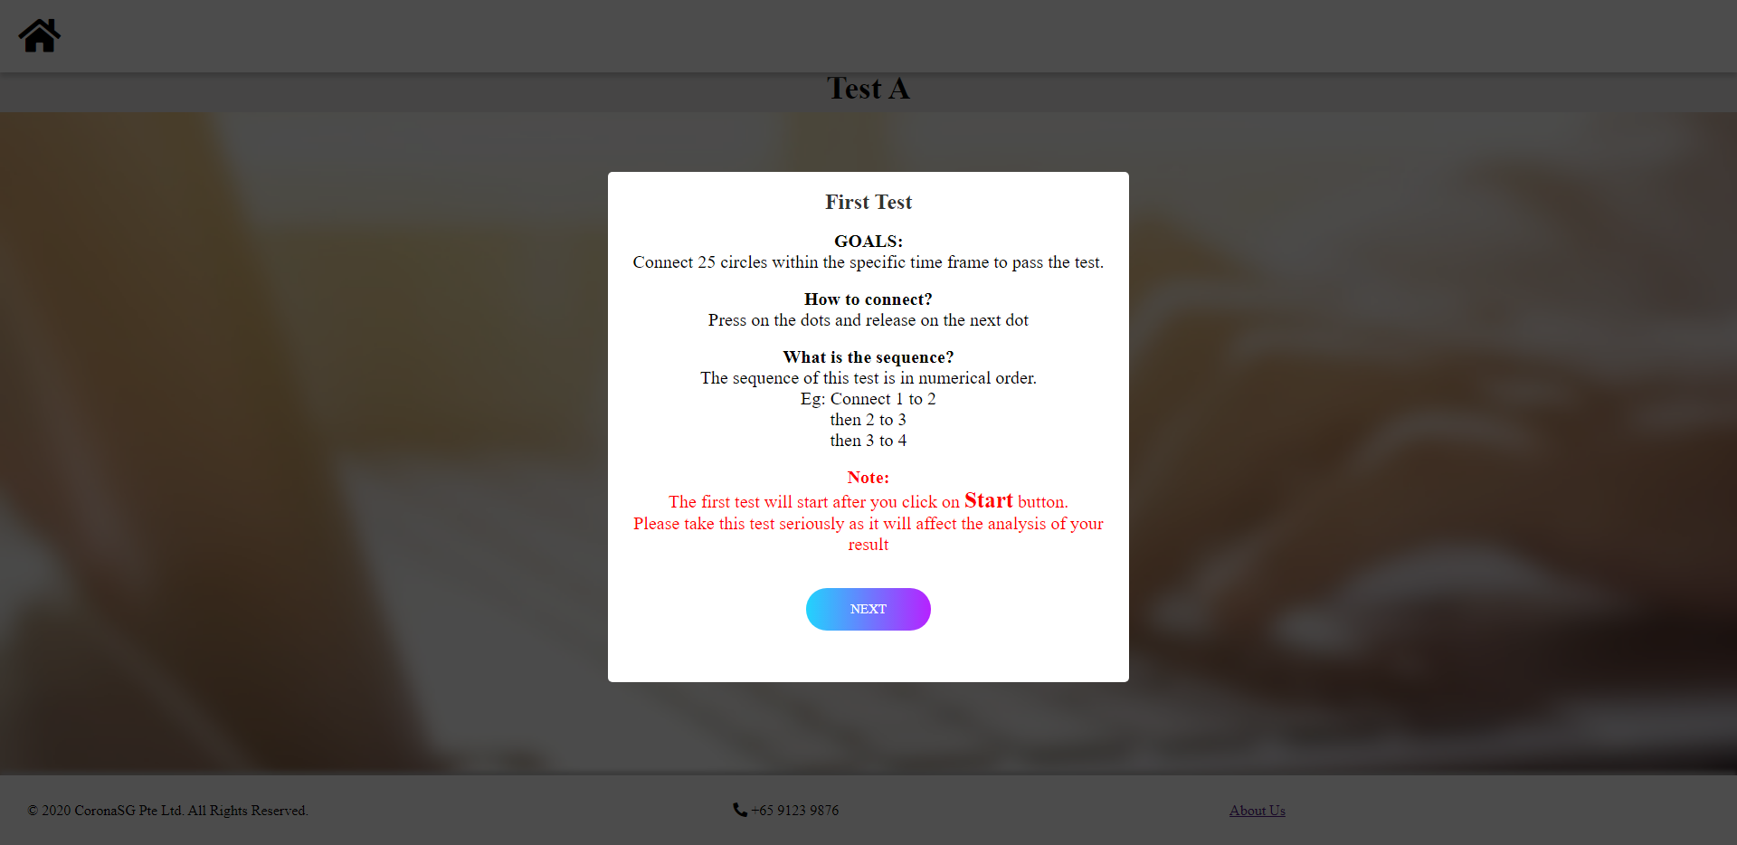
The Test
Declaration
General Instruction
Test A
Test B
Main Page
Testing A
Test A Instructions
Notes:
To start the test user will receive various popup as shown here until user can see the test A page. As you can see, user can user the mouse freely to connect the dots, basically to mimic the effect of the real physical test.

Slide 16
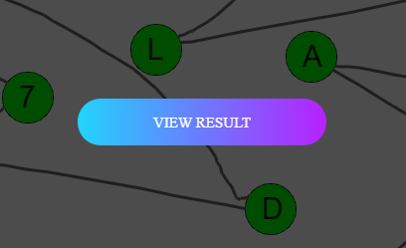
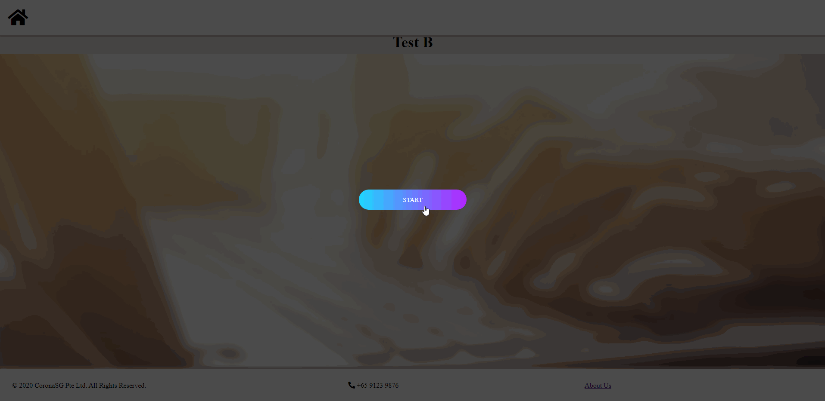
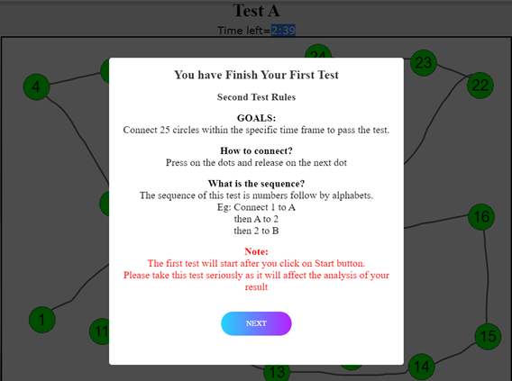
The Test
Test A
Test B
Test B Instructions
Notes:
Similarly, for test B, user will be shown instruction before starting the test. As you can see although I have connected the dots wrongly, but it will fall back to previous success dot and continue from there. Once test B is finish or timeout, the user should be able to view the result.

Slide 17
The Result
Report
Records
List of Records (Doctor Only)
Feedback
Notes:
Once user finish the test, they can view their result aka reports, their past result aka records. For doctor, they will be directly able to access list of records once login into the system.

Slide 18
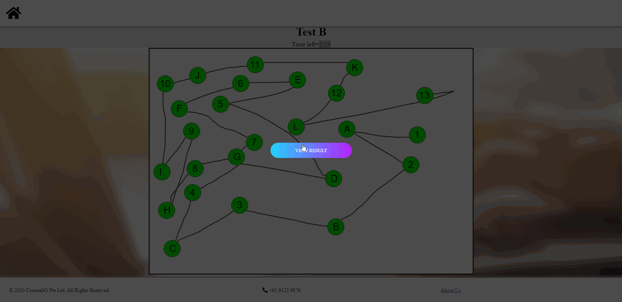
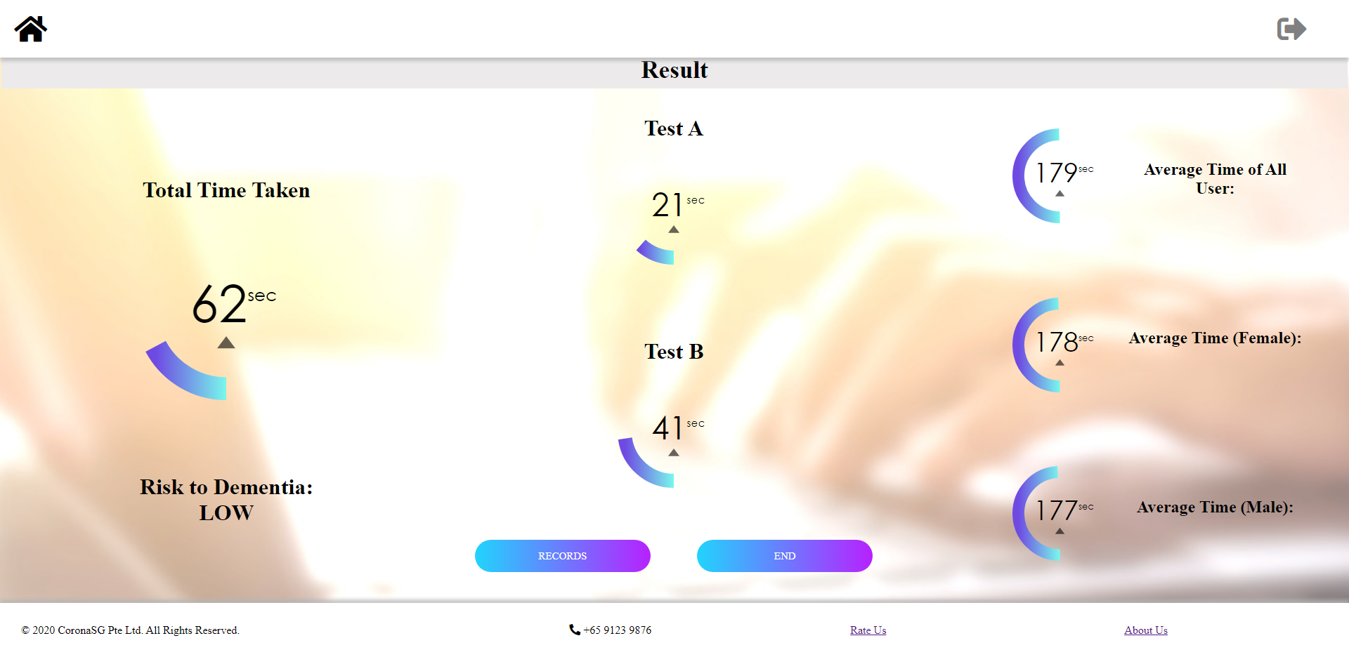
The Result
Report
Records
List of Records (Doctor Only)
Feedback
International Average Time:
Test A : 29 sec
Test B : 75 sec
Both above average : High Risk
Both below average : Low Risk
If not : Medium Risk
Main Page
Notes:
The report consists of the time taken for individual tests as well as both tests. User will able to see average time of others type of result. The risk of dementia is determined based on international average time taken for both test as shown over here. User can check out their records by clicking on the green boxes area as shown here.

Slide 19
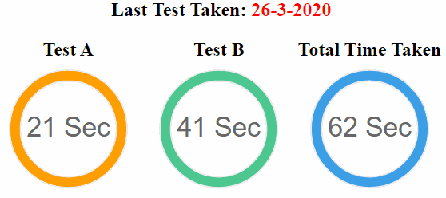

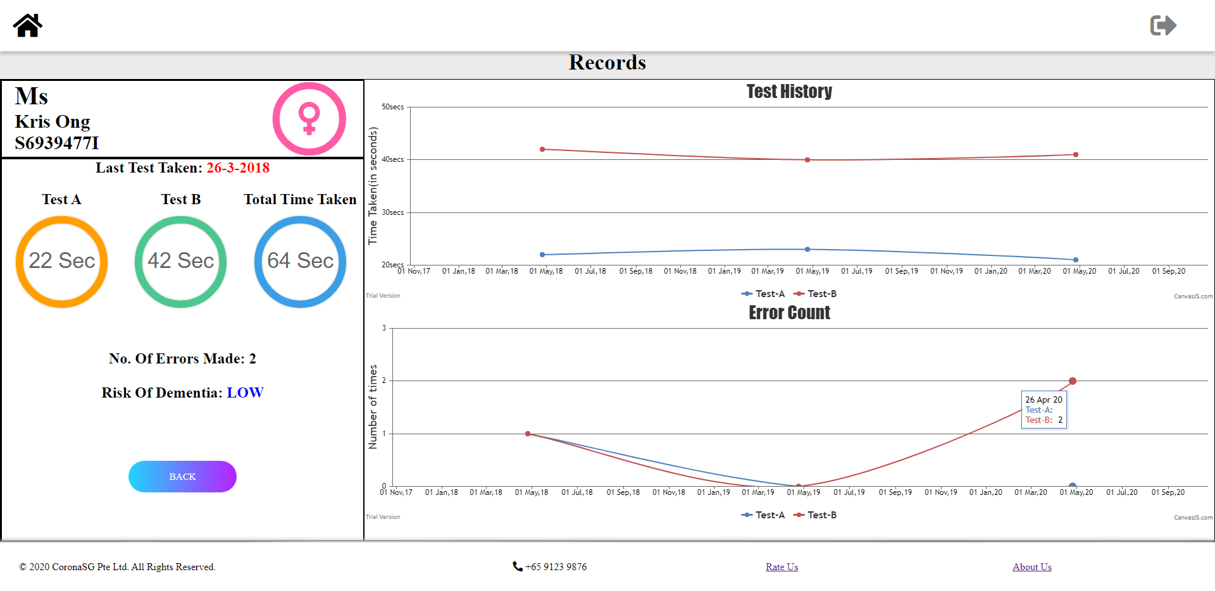
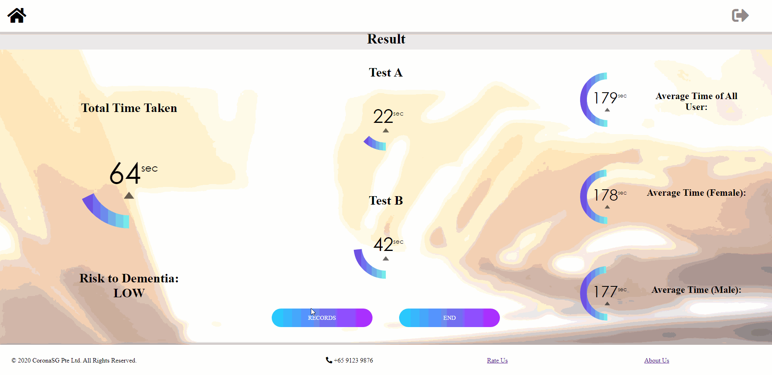
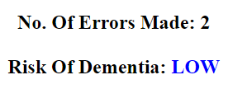
The Result
Latest Test Result
Identity
Report
Records
List of Records (Doctor Only)
Feedback
Past Test Result
Max 3 attempt annually after D.O.B
Result Status
Previous Page
Notes:
The record page consists of different information, firstly, the result status such as the number of errors made and dementia risk. Secondly, the identity of the individual. 3rdly, the latest test result information. Lastly, the yearly graph as this test was taken annual basis and each user has up to 3 maximum attempts after their D.O.B. The graph shows the past test result and the number of errors they made.

Slide 20
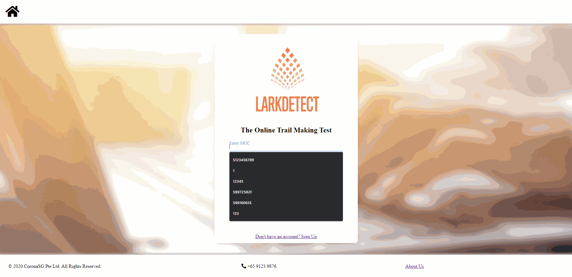
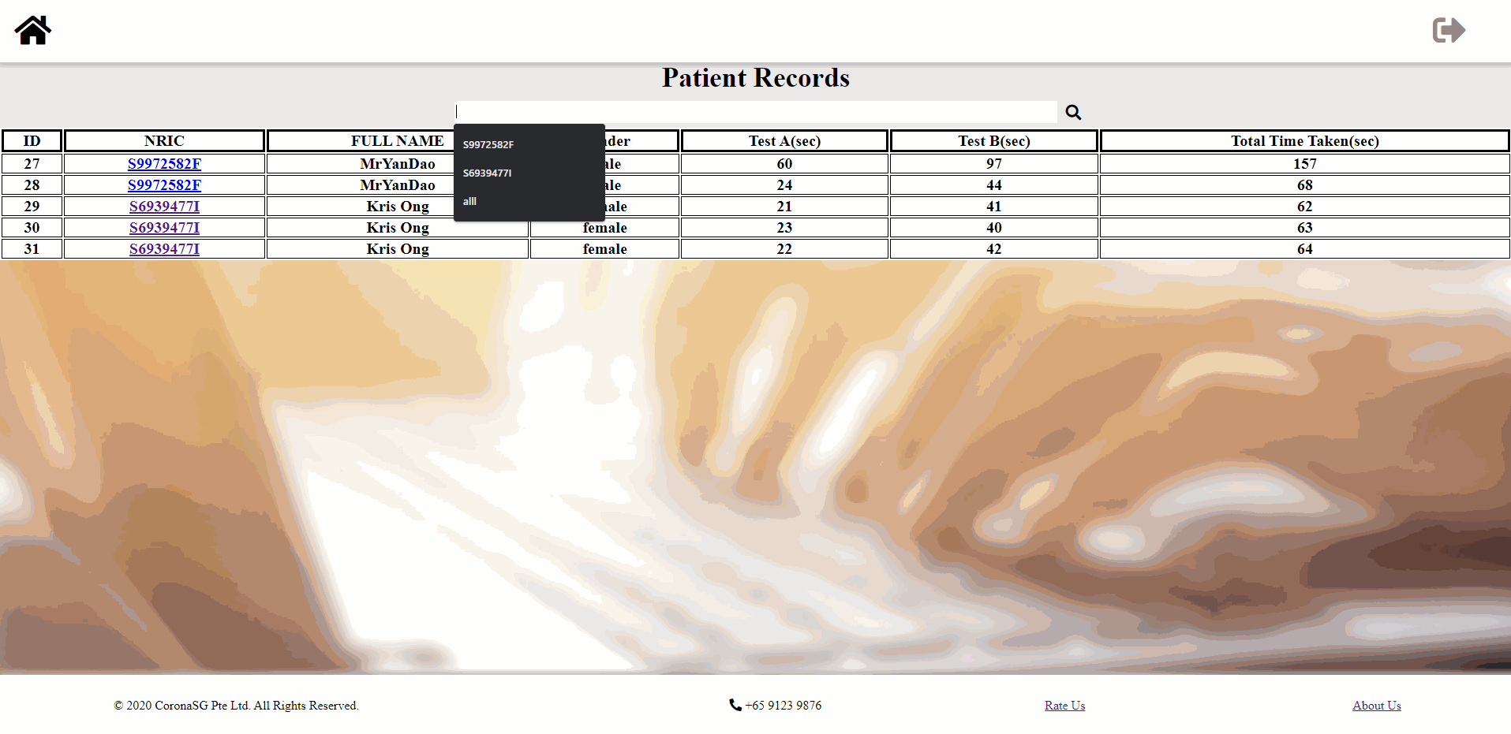
The Result
Login
Report
Records
List of Records
(Doctor Only)
Feedback
Searching
Notes:
This page is only accessible by doctor, where they can perform analysis to determine if patient has dementia. They can search the patient by their NRIC. It should reflect the record of all the individual patients.

Slide 21
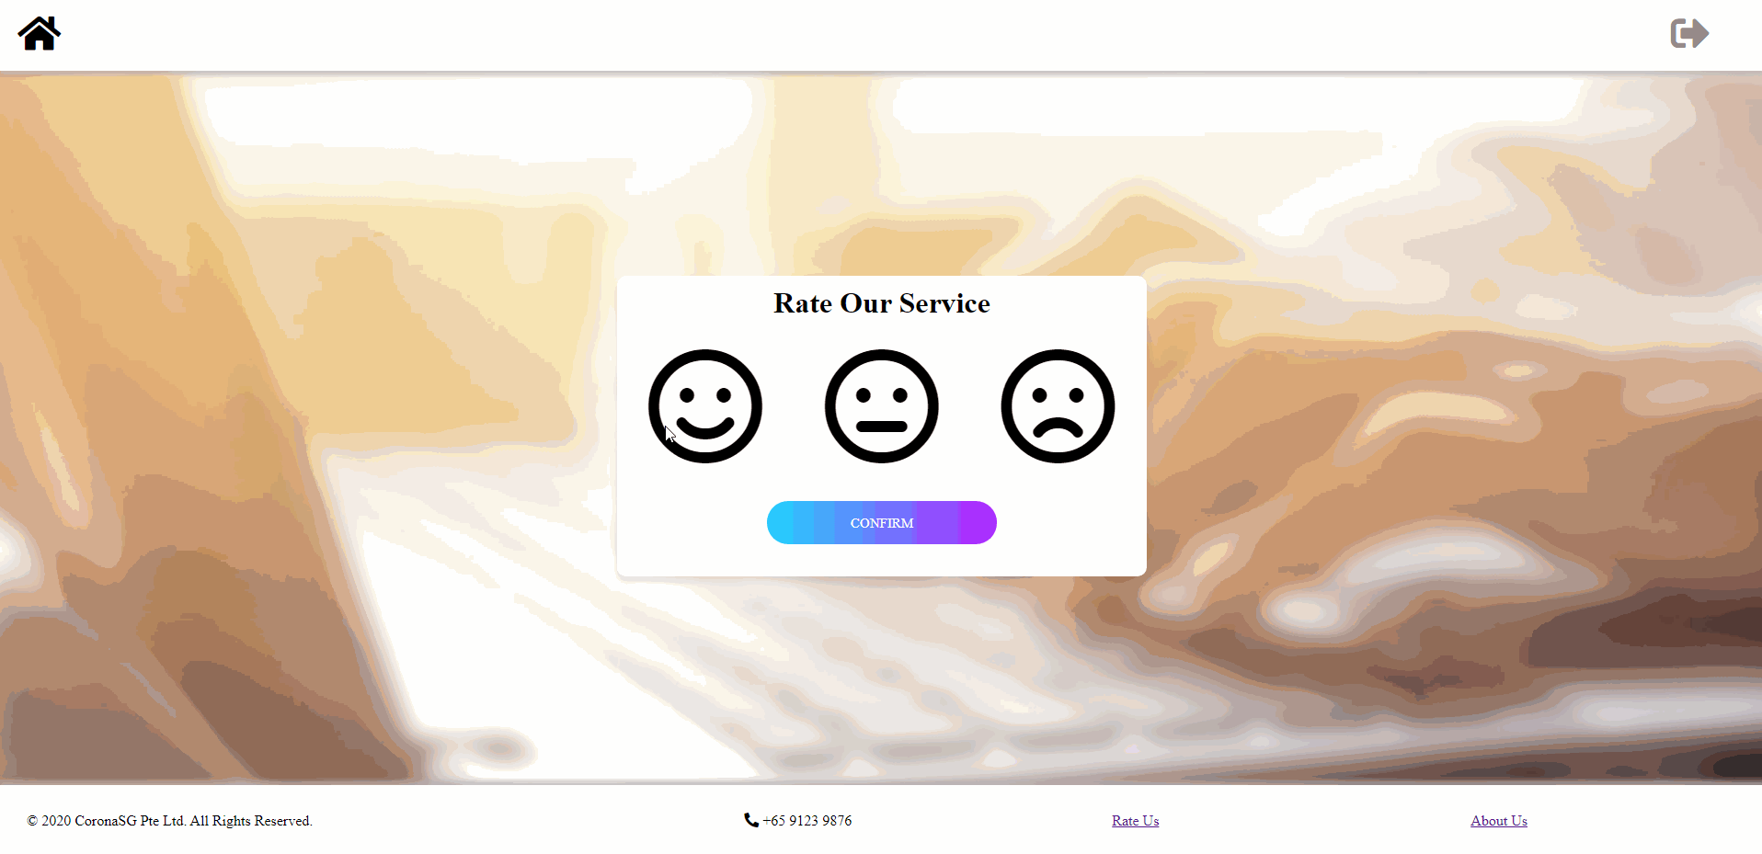

The Result
Report
Records
List of Records (Doctor Only)
Feedback
Notes:
Lastly to understand user experience of our system. User can provide feedback through this page to ensure continuous improvement of our existing system. So, Brenda how to we ensure maintainability in our system?

Slide 22
Design for Maintainability
Notes:
So, Brenda how do we ensure maintainability in our system?

Slide 23
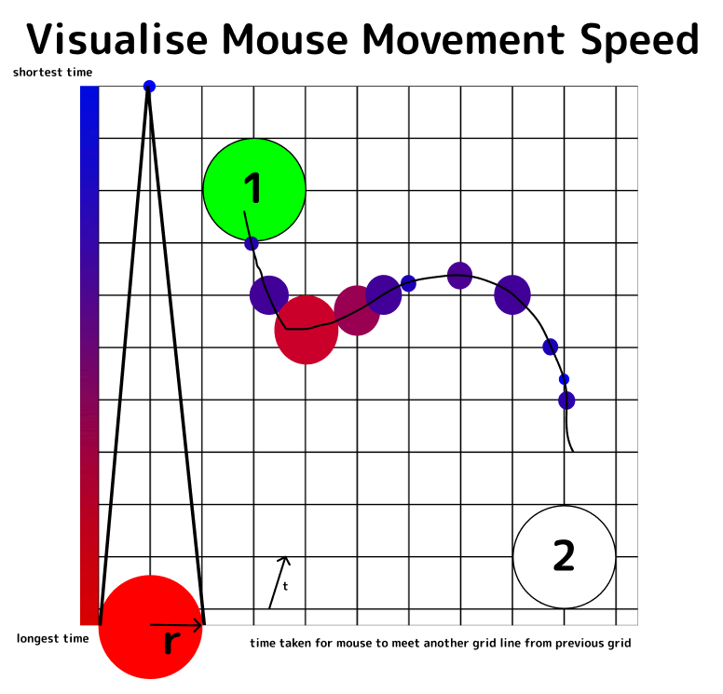
Future Implementations
Improve user interface of LarkDetect webpage
Enhance Data Analysis
Visualise Mouse Movement & Mouse Deviation
Enhance Data Visualisation
Add new graphs in Records page to aid analysis
Integration with HealthHub
Notes:
That is a good question Sam, in order to design a maintainable software, it is important to plan ahead. Early planning puts design problems into perspective and is the most cost effective way for modifying or adding features to software products.
During the early stages of the project, we had planned a few features to be implemented in the future.
Firstly, we would like to improve the user interface of LarkDetect, by doing so we can enhance user experience and make it a more positive one.
Secondly, we would like to work on mouse movement and deviation visualisation to increase the accuracy of our TMT test and strengthen the data analysis being made.
Thirdly, we intend to add new graphs to the Records page, to give the user varied visualisation to help them understand the data better.
Lastly, our final goal is to integrate with HealthHub, a portal allowing Singaporeans and PRs to access their public health records and appointments online.

Slide 24
Maintainability Practices
Readable Code
Version Control
Standardized
Documentation
Modularity
Notes:
In order to reach our goals as mentioned earlier, we have used maintainability practices in software development such as readable code, standardized documentation, version control, and modularity.
By following a set of coding standards, this ensures that code is easily understood by the team as well as possible subcontractors, allowing faster development.
For the documentation, we also have standards put in place for the same reason as coding standards. Consistently formatted documentation simplifies the process of familiarization and makes information easier to locate.
To manage releases, we practice version control in GitHub and SVN. This allows codes, tests and documentation to be kept up to date and synchronized.
Lastly, modular design was used in our software, providing reusable code and reduces redundant coding that might occur in similar functions.
So Emma, can you tell us more about the purpose of Software Quality Assurance?

Slide 25
Software Quality Assurance
Notes:
So Emma, what is the purpose of Software Quality Assurance?

Slide 26
CMMI Level 2
KPAs
Requirement Management
Software Project Planning
Software Project Tracking and Oversight
Software Subcontract Management
Software Quality Assurance
Software Configuration Management
Notes:
Yes Brenda,
Aimed to ensure quality of software products and activities alike,
we implemented Software Quality Assurance as part of enforcing CMMI Level 2.

Slide 27
CMMI Practices
Commitment to perform
Written policies and process guidelines (Project Plan, Quality Plan, Risk Management Plan, Test Plan)
Ability to perform
Team member roles are assigned according to their background experience
Activities to perform
Project Plan WBS and Schedule sets the workload expectation for the team
Measurements and Analysis
Verifying Implementation
Parameters & Matrix
Review & Audit
Weekly review on project progress and/or any blockings
Notes:
Within the five general practices of CMMI Level 2,
Commitment to perform is applied through written policies and process guidelines such as Project Plan, Quality Plan, Risk Management Plan, and Test Plan. Guidelines ensure that team members share the same reference on procedures necessary to carry out each process.
By assigning roles to members based on their individual background experience, we can maximize our team’s ability to perform different tasks. Weekly meetings are conducted to review project progress and to identify any possible blockings.
To set workload expectations for the team, activities to perform are well defined and organized within the WBS and Schedule in our Project Plan.
In Measurement and Analysis, Parameters answer the question of what to measure while the use of matrix answers the question of how.
Lastly, we verify our implementation through the review and audit process.

Slide 28




Key Quality Attributes
Functionality
Usability
Reliability
Integrity
Notes:
For our software product itself, LarkDetect we have chosen four main key quality attributes:
Functionality
it is important for the app to perform its intended functionality in order for the tests to be carried out regularly and for accurate test results to be obtained, such that families can be informed ahead of time should medical attention is necessary.
Usability
Aimed towards an older user base, some potentially unfamiliar with the use of web applications, LarkDetect has to be easily understandable, learnable and usable to the user. This is to mitigate any confusion preventing the user from performing the test to the best of their ability and achieving test results that reflects as such.
Reliability
Singapore has a growing aging population. LarkDetect needs to be reliable at a satisfactory performance rate to handle the increasing traffic of users undergoing the test on an annual basis.
Integrity
LarkDetect records users’ personal data. This information is necessary to monitor a specific user’s performance over time, and to ensure sufficient data for report generation. The system must be able to maintain integrity to prevent potential data loss and/or unauthorized access to this data.

Slide 29
Software Reviews
Project Plan Review
Requirements Analysis Review
Software Design Review
Test Plan Review
Acceptance Review
Notes:
Finally these are the various software reviews conducted throughout different stages of the project development.
in the early stages of planning and development, top row are reviews conducted
as the implementation progresses and a functional prototype of our product emerges, Test plan review and Acceptance review are carried out
So, Yong Xin, with all this CMMI, quality assurance and review activities, how do they all fall into the Project Management? .

Slide 30
Project Management

Slide 31
Project Management
Project Organization
Work Breakdown Structure
Project Estimation
Project Schedule
Notes:
So under project management, we have 4 parts: project organization work breakdown structure project estiamtion and project schedule

Slide 32
Project Organization
Project Manager: Ang Zhan Phung Edmund
Requirement Specification Analyst: Brenda Ng Xin En
System Architecture: Ang Yong Xin
Usability Analyst: Sam Jian Shen
Software Configuration Engineer: Ang Yong Xin, How Mo Xuan
Developers: Sam Jian Shen, How Mo Xuan
Qualiltiy assurance Engineer : Emmanuelle Vania

Slide 33
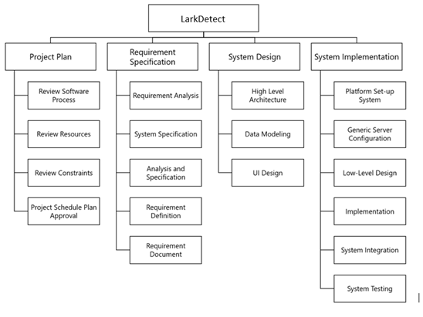
Work Breakdown Structure
Notes:
For the work breakdown structure we divided the entire project into 4 different section:

Slide 34
Project Estimation
Working Hours = 130.78 PD × 8 hours = 1046.24 PH
Hardware= $15,400
Software =$0
Notes:
Left to right?
Lets move on to our project estimation cos, fistly the total working hours per person willl be about 1000 and as for the hardware cost we estimated to be 15,400 and the best things for oiur project is we do not have any software cost in this project.

Slide 35
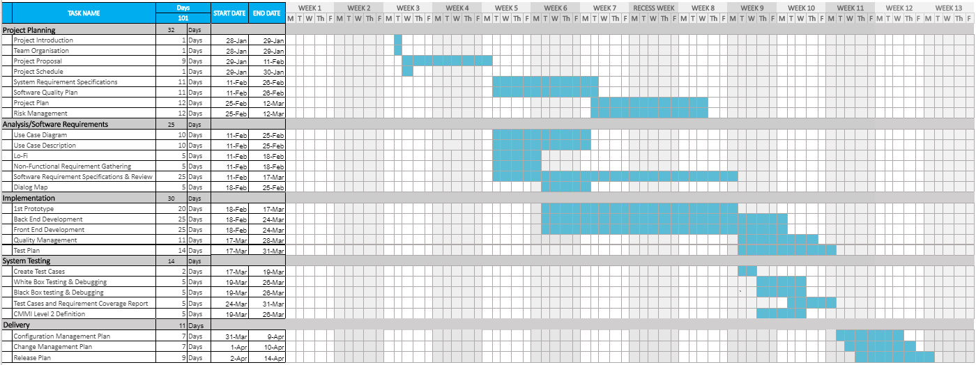
Project Schedule
Notes:
So with this project schedule , Mo Xuan can you share with us what kind of risk we are expecting for our project.

Slide 36
Risk Management
Notes:
So, let me share with you the risk management in our project.

Slide 37
PURPOSE
Risk Management provides the LarkDetect project a consistent method to manage risks to ensure success
Notes:
A risk is an event that if it occurs, it could have a positive or negative effect on the project. The Risk Management Plan defines how risks associated with the LarkDetect project. It outlines how risk management activities will be performed, recorded, and monitored throughout the lifecycle of the project. It provides templates and practices for recording and prioritizing risks.

Slide 38




PROCESS
1. Risk Identification
2. Risk
Analysis
3. Risk
Response
Planning
4. Risk Monitoring
Notes:
The process for risk management breaks into 4 steps.

Slide 39
PROCESS
PROCESS
Enumerate a list of Potential Risks
1
Risk Identification
Risk
Analysis
Risk
Planning
Risk Monitoring
Notes:
The first one is Risk identification, we identify and list down the potential risks.

Slide 40



PROCESS
PROCESS
Prioritise each risk according to severity
2
1. Risk Identification
Risk
Analysis
Risk
Planning
Risk Monitoring
Notes:
The second step is risk analysis, we priotise the risk according to severity

Slide 41
PROCESS
PROCESS
Avoid
Mitigate
Accept
Transfer
3
Risk Identification
Risk
Analysis
Risk
Response
Planning
Risk Monitoring
Notes:
The third step is risk response planning. One of the approaches listed here will be selected to ensure that the risk will not “fall through the cracks”.

Slide 42
PROCESS
Any changes in risks severity?
4
1. Risk Identification
Risk
Analysis
Risk
Planning
Risk Monitoring
Risk Monitoring
Notes:
Lastly, In The risk Monitoring step, The level of risk on a project will be tracked, monitored and reported throughout the project lifecycle.

Slide 43
1. RISK IDENTIFICATION
Identify risks that may affect project outcome and document them in the Risk Register
The Risk Register includes the following:
Unique identifier for each risk
Type of each potential risk
Description of each potential risk event
Assessment of the probability of occurrence and the severity of impact
Strategies proposed for dealing with the risk
Notes:
I will explain the process in more details. We Identify risks that may affect project outcome and document them in the Risk Register. The Risk Register consists of few information, unique identifier, type, description, probability of occurrence, impact and strategies.

Slide 44
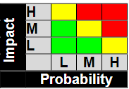
2. RISK ANALYSIS
Qualitative Risk Analysis
Probability:
High >70%
Medium 30% to 70%
Low <30%
Impact
High: greatly impact project cost, project schedule or performance
Medium: slightly impact project cost, project schedule or performance
Low: relatively little impact on cost, schedule or performance
Risk Response Planning is occurred at RED and YELLOW zone
Notes:
In Risk analysis, we analysis the risk from two perspective, probability and impact. Probability and impact are split into three levels. As per the diagram, Risks that fall within the RED and YELLOW zones will have risk response planning.

Slide 45
3. RISK RESPONSE PLANNING
Four types of planning:
Avoid
– Eliminate the threat by eliminating the cause
2. Mitigate
– Identify ways to reduce the probability or the impact of the risk
3. Accept
– Nothing will be done
4. Transfer
– Make another party responsible for the risk (buy insurance, outsourcing, etc.)
Notes:
The third step is risk response planning. There are four types of planning. First one is Avoid, we eliminate the cause of the threat, Second is Mitigate, we identify the ways to reduce the probability & impact of the risk. accept and transfer.

Slide 46
4. RISK MONITORING
Four type of monitoring:
Tracking and monitoring
- Level of risk on a project will be tracked, monitored and reported
‘Top 10 Risk List’
- ‘Top 10 Risk List’ is maintained by project team
3. Project change requests
- Project change requests will be analyzed for their possible impact
Notifying
- Management will be notified of important changes
Notes:
Bold important words

Slide 47
RISK REGISTER
ID | Risk Type | Description of Risk | Probability | Impact | Grade | Potential Indicators | Strategies to tackle
1 | Estimation | Inadequate funding – Inaccurate cost estimates | Medium | High | High | Failure to meet the agreed schedule | Request additional fund Find alternative for high cost item
2 | People | Staff illness at critical times | Medium | High | High | Long working hours and heavy workload | Work handled by 2-3 people Documentation
3 | System | System Performance issue | Low | High | Medium | Clients complained that the response time is slow | Progressive benchmark to ensure that the performance meets user’s expectation
Notes:
In the risk register, here we highlight 3 important point from the report. Firstly, Inadequate cost estimate would lead to the failure of meeting schedule, which is of high risk.
And at moment like this, the staff illness is very important. it would cause longer working hours for the rest of the teammates. This will need to be mitigated by ensuring minimum of 2 personnel handling the same scope of work.
So, these r the critical risks that all personnel need to be aware of.
Don’t read everything.
Second risk highlight is critical in moment like this where the covid virus on on-going.

